Slide 1

Department of Information Technology
NBA Accredited A.P. Shah Institute of Technology G.B.Road,Kasarvadavli, Thane(W), Mumbai-400615 UNIVERSITY OF MUMBAI Academic Year 2021-2022

Slide 2
A Project Report on E-Fresh: Computer Vision and IoT Based Framework for Fruit Freshness Detection Submitted in partial fulfillment of the degree of Bachelor of Engineering(Sem-8) in INFORMATION TECHNOLOGY By Akshata Gawas 18104039
Krishita Tolia 18104021
Siddhesh Gaikwad 18104069
Under the Guidance of Prof. Kiran Deshpande, Prof. Kaushiki Upadhyaya, and
Prof. Sonal Jain

Slide 3
1.Project Conception and Initiation

Slide 4
1.1 Abstract
Detection of defected fruits and the classification of fresh and rotten fruits represent one of the major challenges in the agricultural fields. Rotten fruits may cause damage to the other fresh fruits if not classified properly. Traditionally this classification is done by men, which is labour-intensive, time taking, and not efficient procedure. Thus, factories need human intervention for segregation of fruits
Hence, we need an automated system which can reduce the efforts of humans and time of production. Our system will automatically do that with help of CNN classification Algorithm. The proposed idea will create a segregation model which would need no human intervention for classifying and segregating fruits.

Slide 5
1.2 Objectives
Classification of fruit into fresh and rotten.
To achieve industry 4.0 standards by integrating machine learning and sensors.
To perform data visualization on classification of fruits on tableau and blynk.

Slide 6
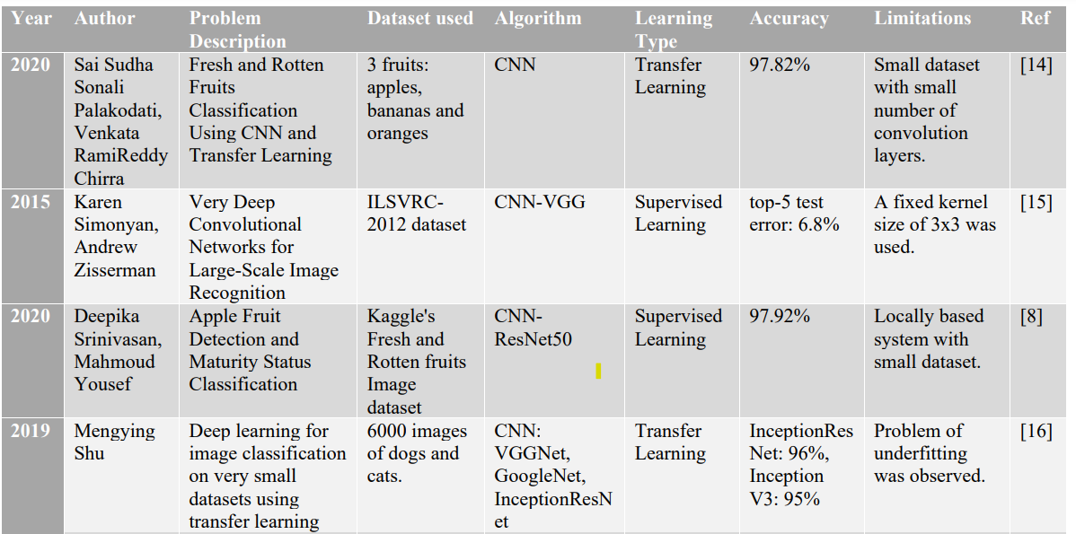
1.3 Literature Review

Slide 7
1.4 Problem Definition
.
The food industry is expanding every day and it is crucial to maintain the required standards which impact their market value. To maintain these standards, manpower is used which is inconsistent, expensive, and time-consuming. With the help of automation of classification, we can speed up this process with less expensive resources using Computer Vision along with the Internet of Things(IoT). The evolution of the Internet of Things(IoT) has played an important role in making the devices smarter and more connected. The large amount of data collected from these devices can be used for data analysis which helps the industries to plan their future decisions. This project proposes the idea of implementing an infrastructure having a micro-controller that would accurately segregate three kinds of fruits into two categories i.e. Fresh and Rotten

Slide 8
1.5 Scope
Can be applied in domestic use.
Can be useful in food industry .

Slide 9
1.6 Technology stack
Hardware Requirements:
NodeMCU ESP8266
ESP32 Camera Module
Motor/ Rotator(for conveyor belt)
Wi-Fi module
Flaps
Servo-motor
Alcohol Sensor(MQ3), Methane Sensor(MQ4)

Slide 10
Software Requirements:
Google Colab
Tensorflow, Keras, Pandas, Numpy, Matplotlib.
Tableau

Slide 11
1.7 Benefits for environment & Society
Processing of fruits and vegetables alone generates a significant waste, which amounts to 25–30% of the total product. We need a system which helps us to reduce wastage so that we could increase the yield
We need a system which is technology driven rather than human driven to increase accuracy and efficiency whereas reduce human labour.

Slide 12
2. Project Design

Slide 13
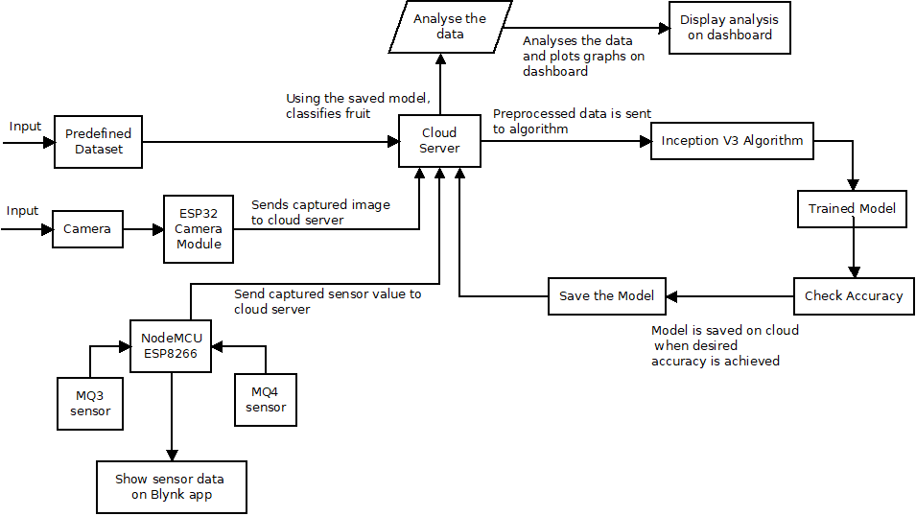
2.1 Proposed System
Fig 1: System Architecture

Slide 14
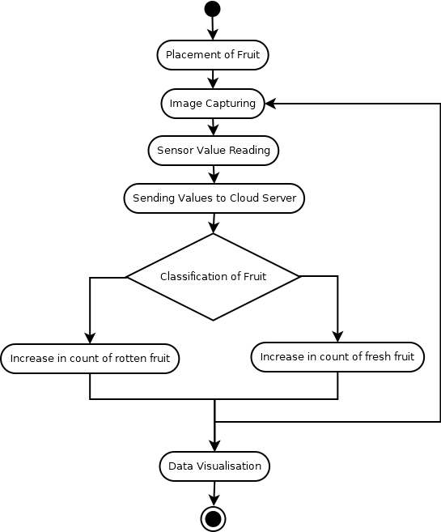
2.2 Design(Flow Of Modules)
Fig 2: Flow of Modules

Slide 15
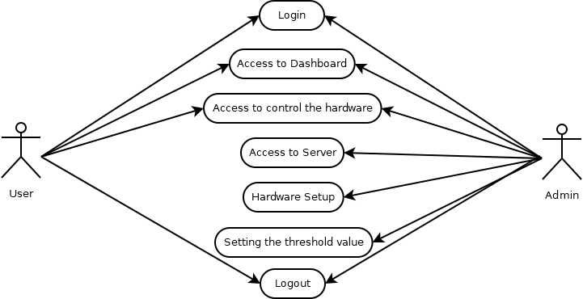
2.3 Description Of Use Case
Fig 3: Use Case

Slide 16
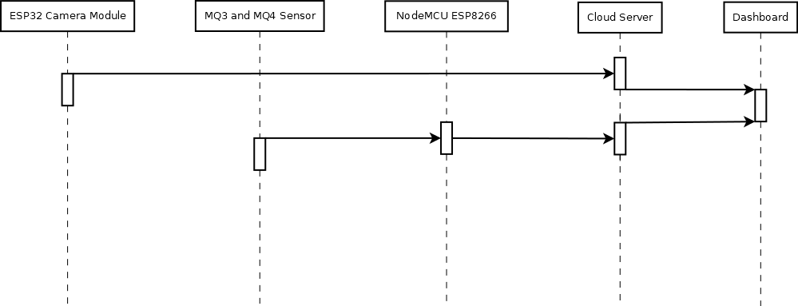
2.4 Sequence Diagram
Fig 5: Sequence Diagram

Slide 17
3. Implementation

Slide 18
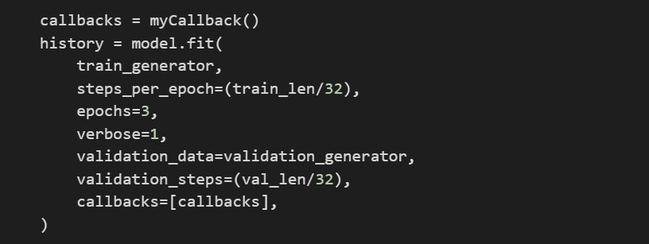
Fig 6: Model Training

Slide 19
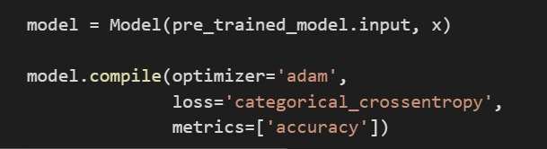
Fig 7: Model Compilation

Slide 20
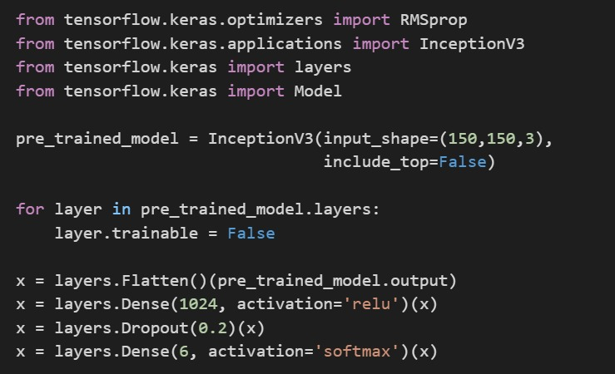
Fig 8: Importing Inception V3 Model

Slide 21
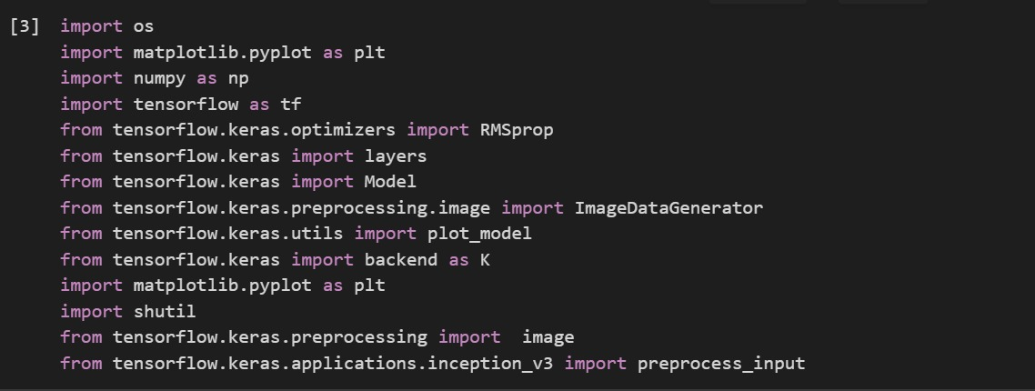
Fig 9: Importing Libraries

Slide 22
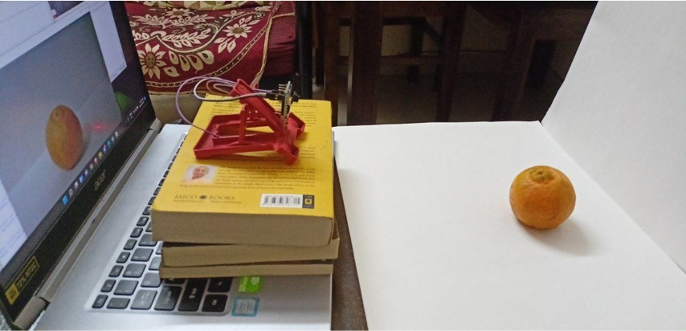
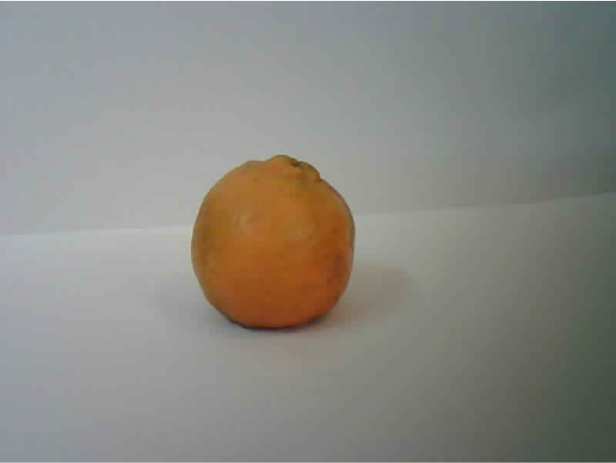
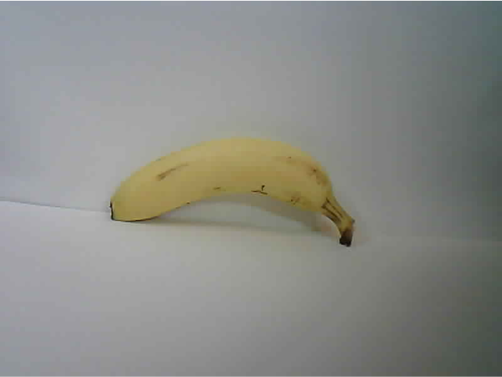
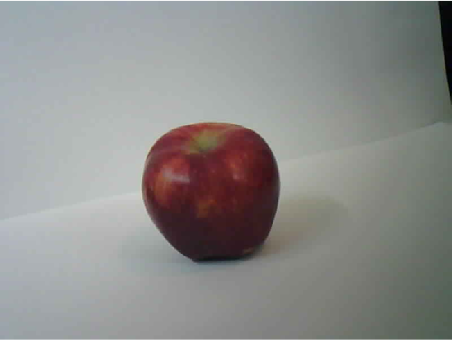
Fig 10: Dataset

Slide 23
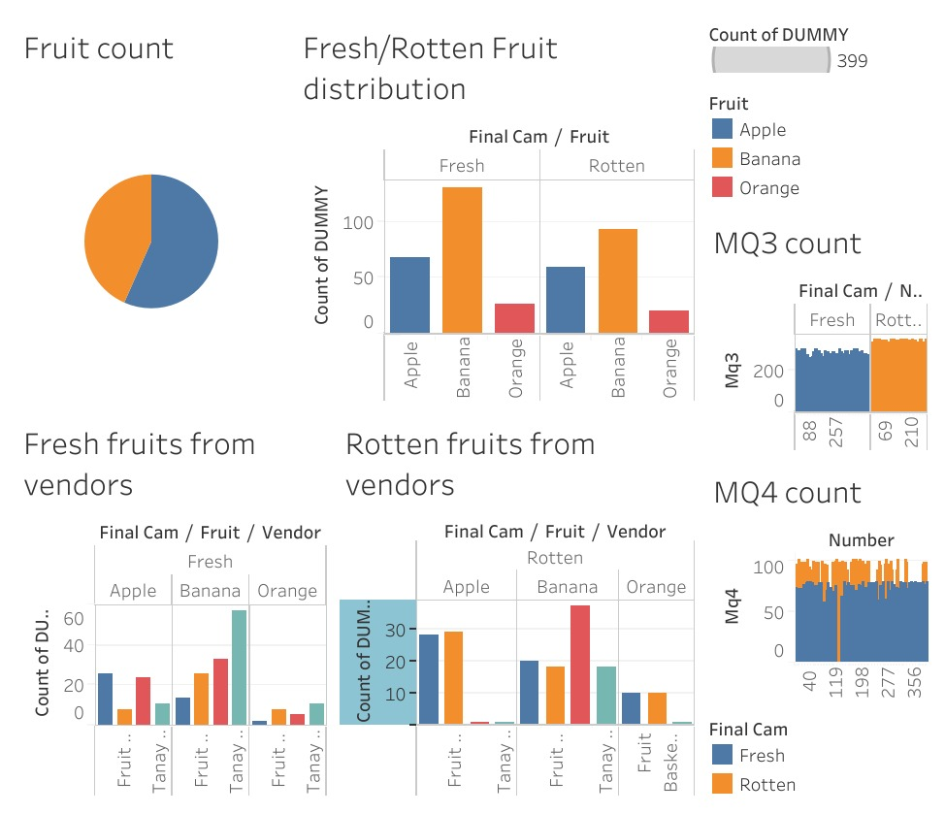
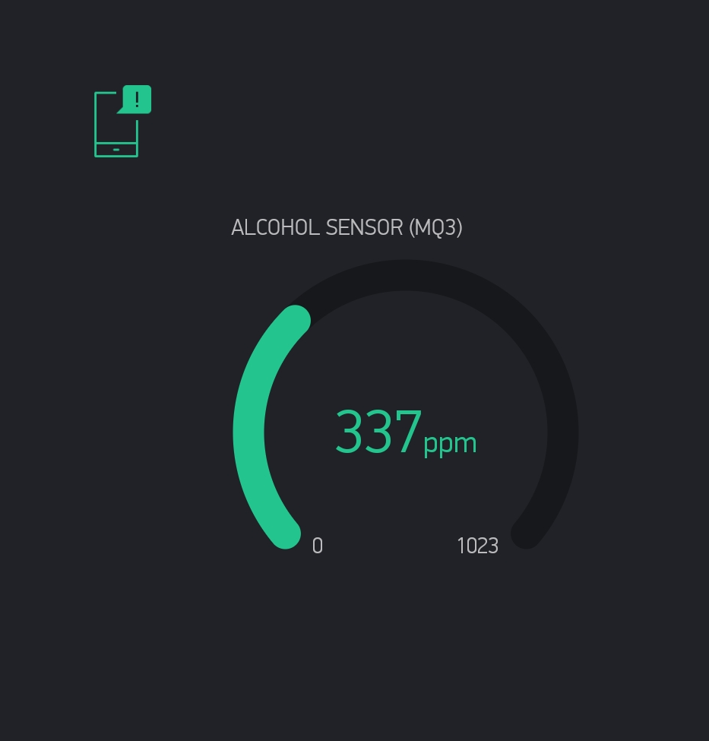
Fig 11 : Dashboard

Slide 24
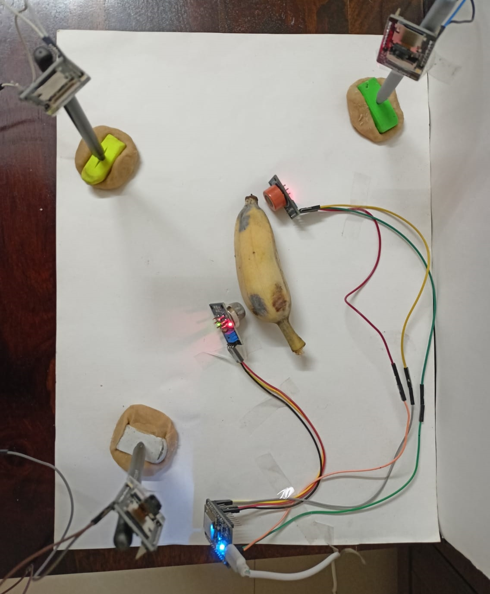
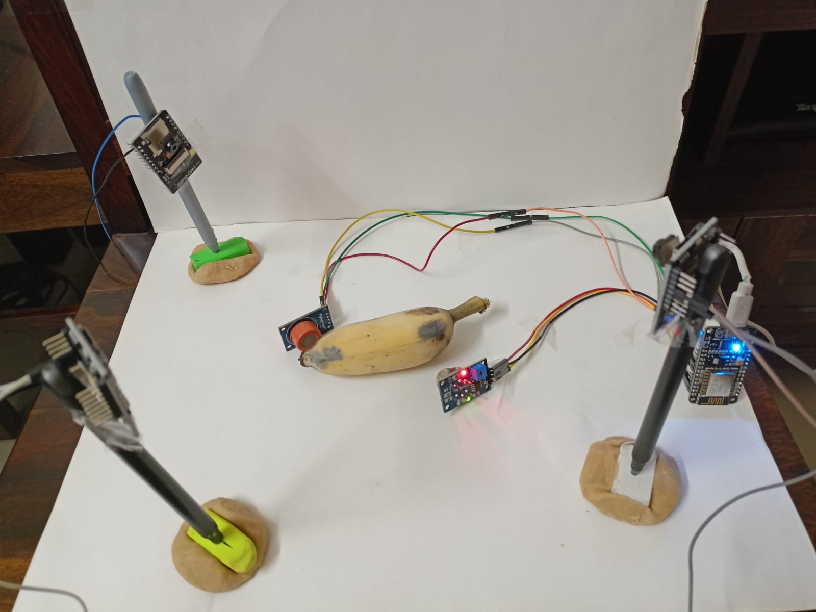
Fig 12 : Hardware Setup

Slide 25
4. Testing

Slide 26
Unit Testing
Unit Testing is a type of software testing where individual units or components of a software are tested. The purpose is to validate that each unit of the software code performs as expected. It is a very useful technique that can help you prevent obvious errors and bugs in your code. It involves testing individual units of the source code, such as functions, methods, and class to ascertain that they meet the requirements and have expected behaviour. Unit tests are usually small and don’t take much time to execute. In our case we began writing code for our machine learning algorithm and sensors in form of units. We then tested each unit separately to minimize the error. Isolating the code helps in revealing unnecessary dependencies between the code being tested and other units or data spaces in the product. These dependencies can then be eliminated.

Slide 27
Integration Testing
Integration testing is defined as a type of testing where software modules are integrated logically and tested as a group. A typical software project consists of multiple software modules, coded by different programmers. The purpose of this level of testing is to expose defects in the interaction between these software modules when they are integrated. Similarly we divided our code into single unit. After each unit has been thoroughly tested, it is combined with other units to form modules. This testing facilitates smooth integration of software and hardware, if any error is encountered it will be resolved for that specific unit

Slide 28
5. Result

Slide 29
The process of recognizing, classifying, and segregating fruits according to their freshness is proposed in this paper. CNN architecture, i.e., Inception-V3 using transfer learning, is implemented in this proposed framework. Datasets with different fruits such as apple, banana, orange are used to train and test the model. The accuracy of the trained model with epochs 100 and batch-size 16 was recorded as 99.17. A touch of the Internet of things (IoT) is given to the architecture by using sensors, camera modules and sending data over the internet to the trained model stored on a cloud. Sensors give an additional advantage along with image classification to filter fresh and rotten fruits. While designing the hardware model, the standards of Industry 4.0 were kept in consideration. This proposed framework would aid the food industries as a considerable amount of capital and time is spent on labor-intensive and repetitive tasks. So to conquer the drawbacks, this proposed framework can be implemented. Data analysis will provide information about the fruits, which will, in turn, state their impact on the production. Further, the analytical report will be prepared on the web portal. CNN architecture, i.e., Inception-V3 using transfer learning, is implemented in this proposed framework.

Slide 30
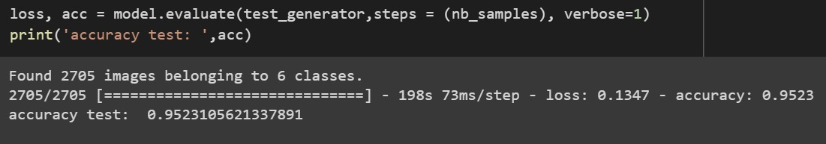
Fig 11: Accuracy

Slide 31
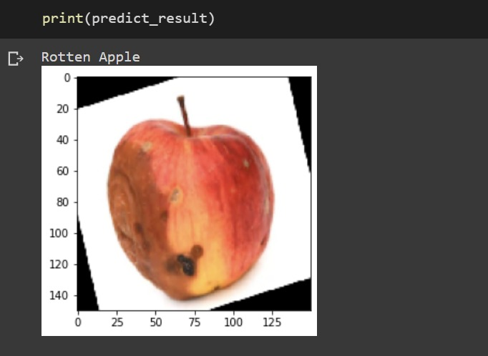
Fig 12: Predicted Value

Slide 32
6. Conclusion and Future Scope

Slide 33
Our main aim is to create a automated segregation tool for fruit industry which can be used in place of human labour. The tool will also provide important insight using the data captured during segregation
By giving large number of relevant data will increase the accuracy of the system.
Camera with advance specifications will increase the accuracy as compared to the current system.
We can further include more varieties of fruits for classification.

Slide 34
References
Deepika Srinivasan, Mahmoud Yousef, ”Apple Fruit Detection and Maturity Status Classification”, International Journal of Recent Technology and Engineering (IJRTE) ISSN:2277-3878, Volume-9 Issue-2, July 2020
Nguyen Truong Thinh, Nguyen Duc Thong, and Huynh Thanh Cong, “Mango Classification System Based on Machine Vision and Artificial Intelligence,” Ho Chi Minh City University of Technology, VNU HCMC, 2019 IEEE 7th International Conference on Control
Yuhang Fu,”Fruit Freshness Grading Using Deep Learning”

Slide 35
Paper Publication
Paper published on IEEE Xplore digital library through International Conference on Advances in Computing, Communication and Control (ICAC3 2021)

Slide 36
Thank You

